Slide 1
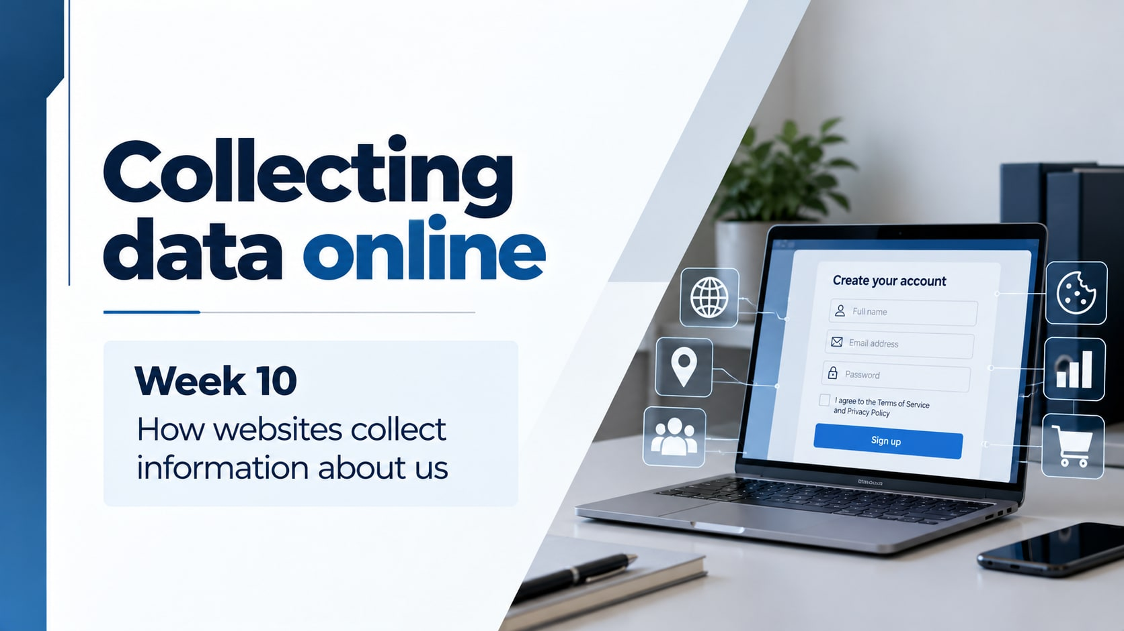
Notes:
Introduce Unit 2 Staying safe online and section 2.1. Learning goals: explain why websites collect data, distinguish useful cookie functions from privacy concerns, and justify a decision about unnecessary information. Book printed pages 32–37. This deck covers Lesson 1 only.
Visuals: original AI-generated images. Curriculum: https://github.com/rayjoshuaa/rayjoshuaa.github.io/blob/main/lesson-content-y7.js . Textbook: Oxford International Lower Secondary Computing Student Book 7, section 2.1, printed pages 34–37.

Slide 2
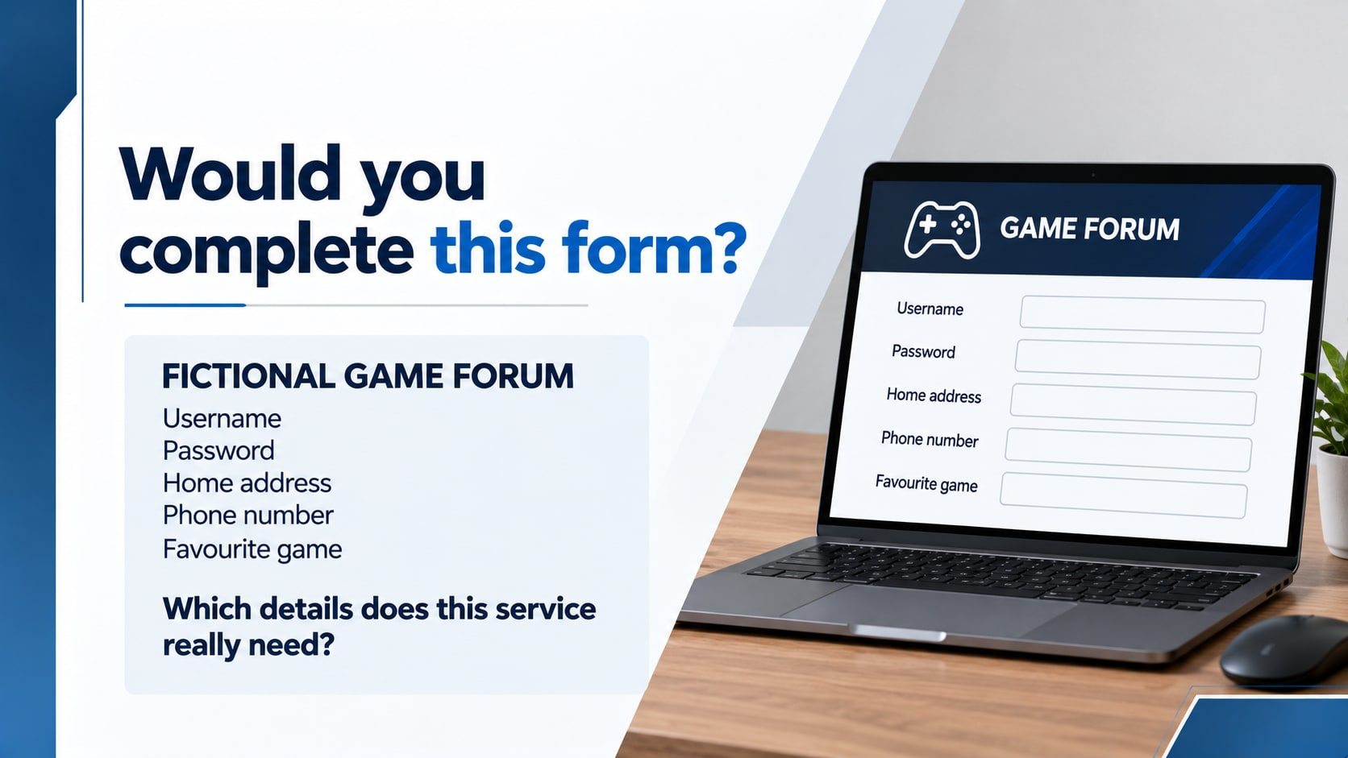
Notes:
Hook: ask pupils to work in pairs and decide which fields they would question. Do not enter any real information. The service is a fictional game discussion forum, not a shop. Username and password can support an account. Favourite game is optional. An address and phone number need a convincing purpose and are unnecessary for this example. Required on a form does not automatically mean reasonable.
Visuals: original AI-generated images. Curriculum: https://github.com/rayjoshuaa/rayjoshuaa.github.io/blob/main/lesson-content-y7.js . Textbook: Oxford International Lower Secondary Computing Student Book 7, section 2.1, printed pages 34–37.

Slide 3
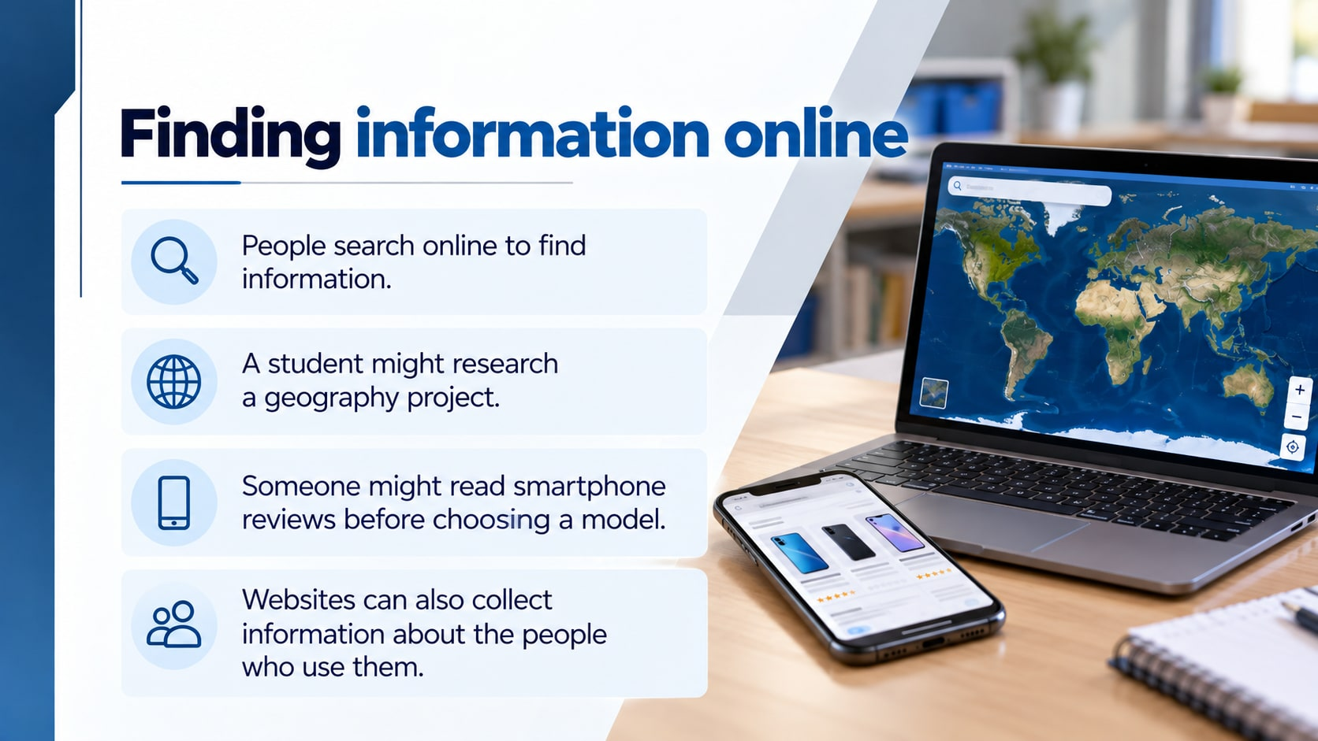
Notes:
Textbook page 34: discuss searching for geography information and smartphone reviews. Websites may collect information about users.
Visuals: original AI-generated images. Curriculum: https://github.com/rayjoshuaa/rayjoshuaa.github.io/blob/main/lesson-content-y7.js . Textbook: Oxford International Lower Secondary Computing Student Book 7, section 2.1, printed pages 34–37.

Slide 4

Notes:
Explain registration using book page 34. Some sites use other sign-in methods, so this is a simplified example rather than a universal rule. Discuss account benefits such as saving work or posting comments. Pupils should follow the teacher-approved route for any account and never share a real password in class. Make sure pupils distinguish a username from their full legal name.
Visuals: original AI-generated images. Curriculum: https://github.com/rayjoshuaa/rayjoshuaa.github.io/blob/main/lesson-content-y7.js . Textbook: Oxford International Lower Secondary Computing Student Book 7, section 2.1, printed pages 34–37.

Slide 5

Notes:
Book page 34. Discuss why people register and which account features may be available. Do not use real personal details.
Visuals: original AI-generated images. Curriculum: https://github.com/rayjoshuaa/rayjoshuaa.github.io/blob/main/lesson-content-y7.js . Textbook: Oxford International Lower Secondary Computing Student Book 7, section 2.1, printed pages 34–37.

Slide 6

Notes:
Textbook page 34: discuss required and optional information in a fictional registration form.
Visuals: original AI-generated images. Curriculum: https://github.com/rayjoshuaa/rayjoshuaa.github.io/blob/main/lesson-content-y7.js . Textbook: Oxford International Lower Secondary Computing Student Book 7, section 2.1, printed pages 34–37.

Slide 7
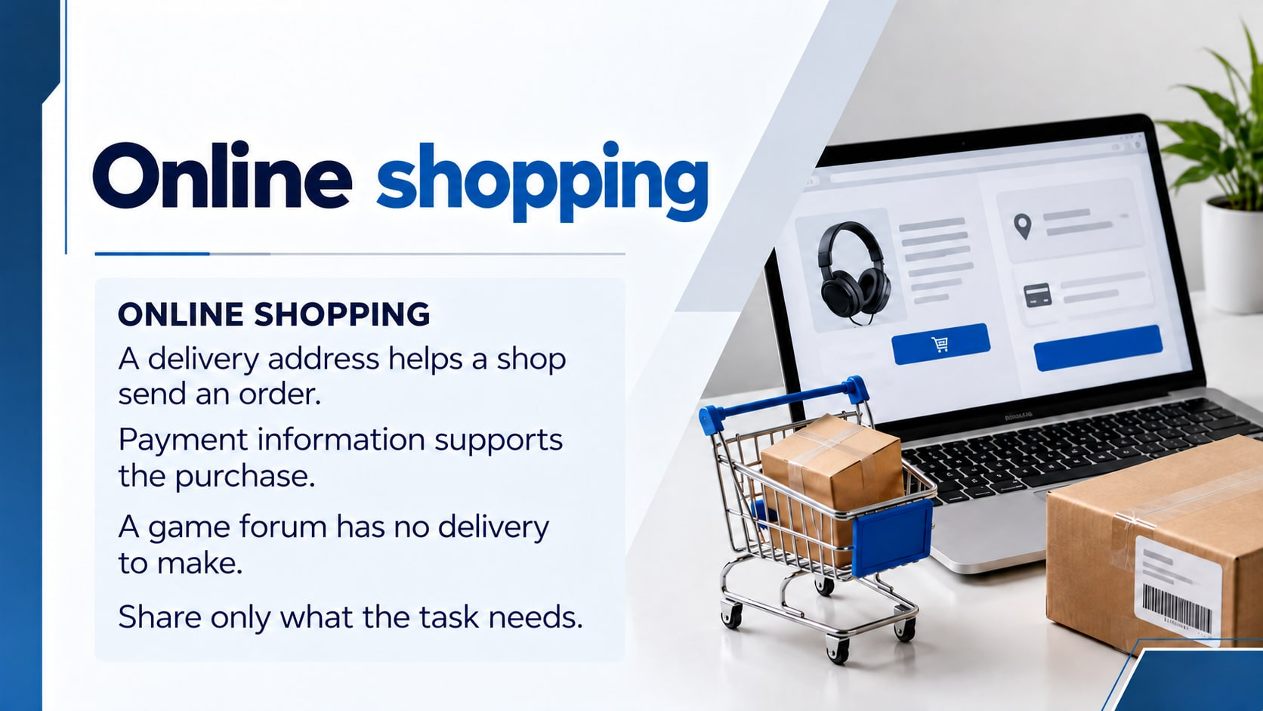
Notes:
Use book page 35. E-commerce means buying and selling online. A shop may use a payment provider instead of directly receiving bank details. Children should not make purchases or type payment details for this activity. Ask why a delivery address makes sense for a physical parcel but not for a discussion-only game forum.
Visuals: original AI-generated images. Curriculum: https://github.com/rayjoshuaa/rayjoshuaa.github.io/blob/main/lesson-content-y7.js . Textbook: Oxford International Lower Secondary Computing Student Book 7, section 2.1, printed pages 34–37.

Slide 8

Notes:
Explain encryption as making transmitted information unreadable to someone intercepting it without the keys. HTTPS does not prove the operator is honest. Browser security indicators vary, so do not teach a padlock icon as a universal current interface. Sources: https://https.cio.gov/faq/ and https://consumer.ftc.gov/articles/online-shopping . Use a fictional site example. Do not ask pupils to visit unknown websites.
Visuals: original AI-generated images. Curriculum: https://github.com/rayjoshuaa/rayjoshuaa.github.io/blob/main/lesson-content-y7.js . Textbook: Oxford International Lower Secondary Computing Student Book 7, section 2.1, printed pages 34–37.

Slide 9
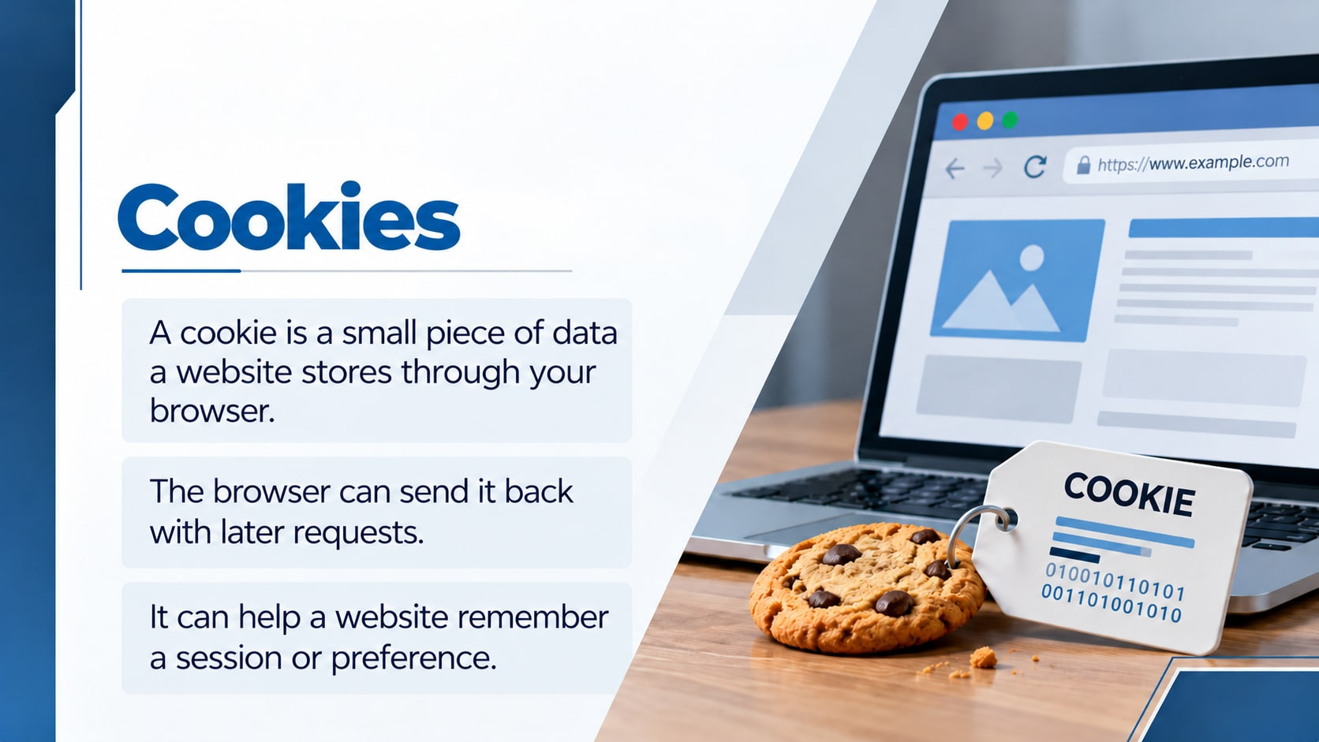
Notes:
Use book page 36. Distinguish a web cookie from a biscuit and from an entire database or a program. A cookie may contain an identifier that refers to information stored on the website's server. It does not automatically contain all of a person's private information. Source: https://developer.mozilla.org/en-US/docs/Web/HTTP/Guides/Cookies . Ask pupils for something a site might need to remember.
Visuals: original AI-generated images. Curriculum: https://github.com/rayjoshuaa/rayjoshuaa.github.io/blob/main/lesson-content-y7.js . Textbook: Oxford International Lower Secondary Computing Student Book 7, section 2.1, printed pages 34–37.

Slide 10
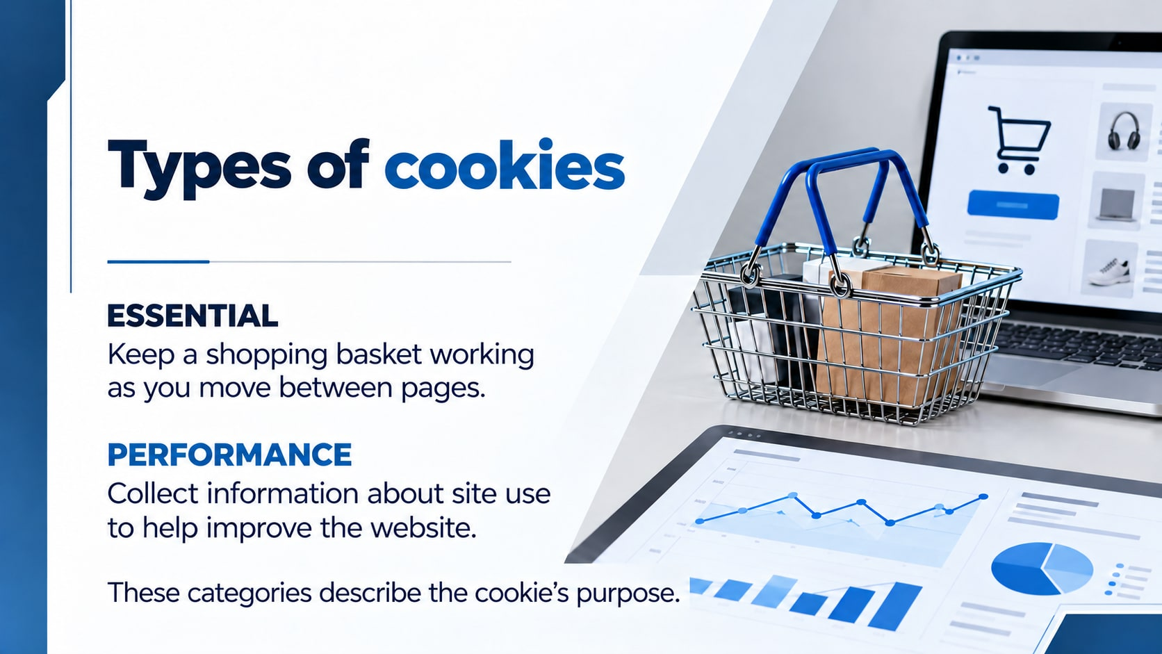
Notes:
Use the book's four-category model. Essential functions include maintaining a basket or login session. Performance cookies can support analytics about how a site is used. Do not assume analytics is anonymous or required; its privacy implications depend on implementation. These categories are a teaching model, and not every website uses all four. Ask pupils to give the purpose before naming the category.
Visuals: original AI-generated images. Curriculum: https://github.com/rayjoshuaa/rayjoshuaa.github.io/blob/main/lesson-content-y7.js . Textbook: Oxford International Lower Secondary Computing Student Book 7, section 2.1, printed pages 34–37.

Slide 11
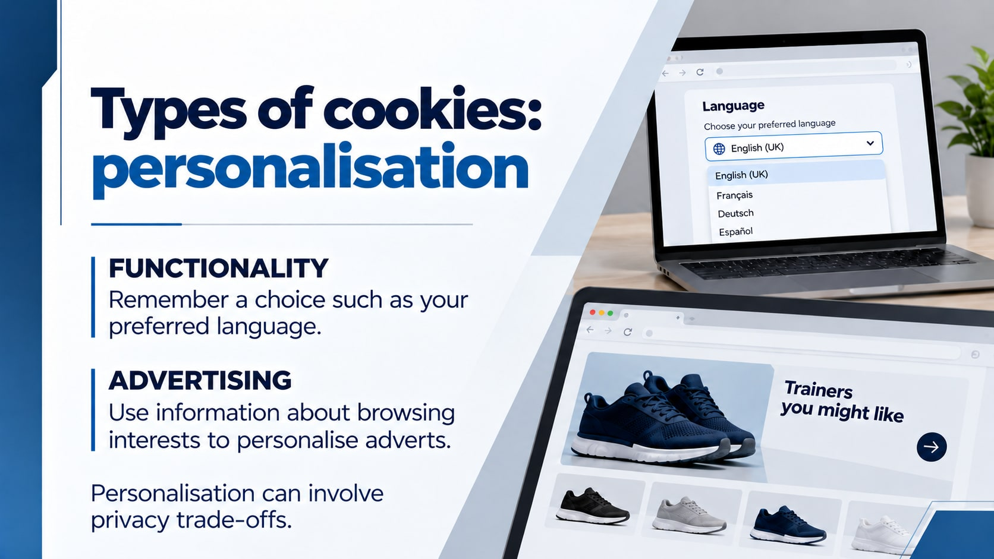
Notes:
Book page 36. Functionality cookies remember choices. Advertising cookies may help build a picture of interests, including across websites where tracking is possible. Browser protections vary and may restrict tracking. A personalised advert does not prove a website knows every detail about a person. Sources: https://developer.mozilla.org/en-US/docs/Web/HTTP/Guides/Cookies and https://developer.mozilla.org/en-US/docs/Web/Privacy/Guides/Third-party_cookies .
Visuals: original AI-generated images. Curriculum: https://github.com/rayjoshuaa/rayjoshuaa.github.io/blob/main/lesson-content-y7.js . Textbook: Oxford International Lower Secondary Computing Student Book 7, section 2.1, printed pages 34–37.

Slide 12
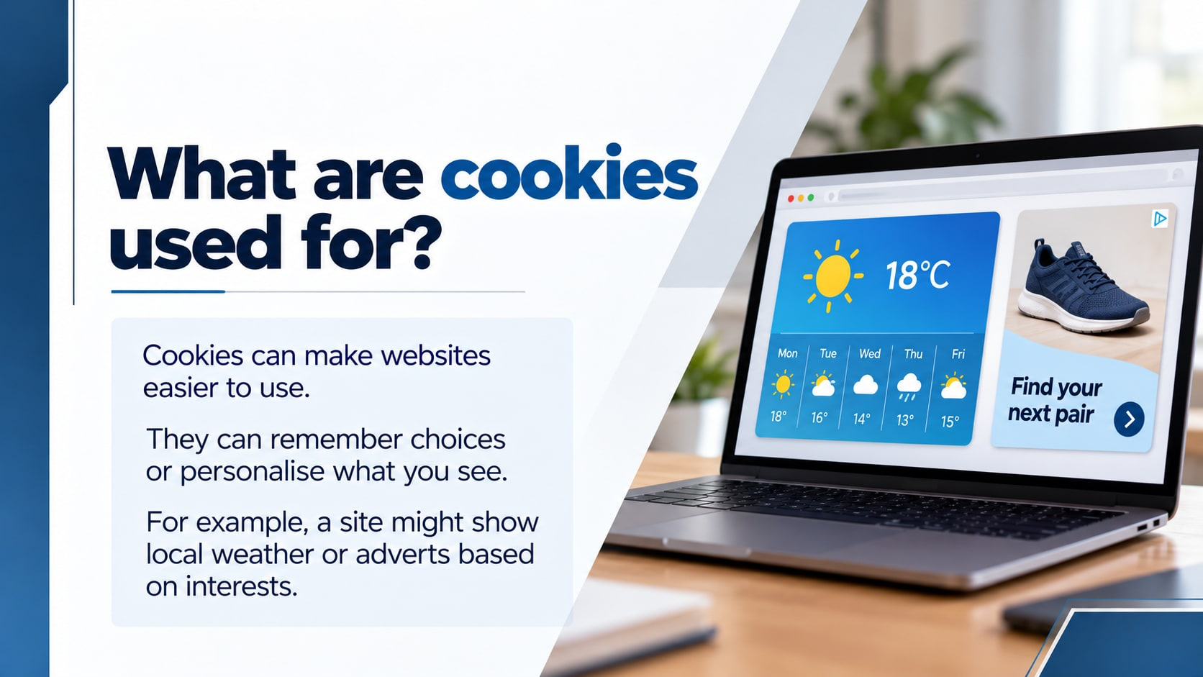
Notes:
Textbook page 36: discuss convenience and personalisation using local weather and advertising examples.
Visuals: original AI-generated images. Curriculum: https://github.com/rayjoshuaa/rayjoshuaa.github.io/blob/main/lesson-content-y7.js . Textbook: Oxford International Lower Secondary Computing Student Book 7, section 2.1, printed pages 34–37.

Slide 13
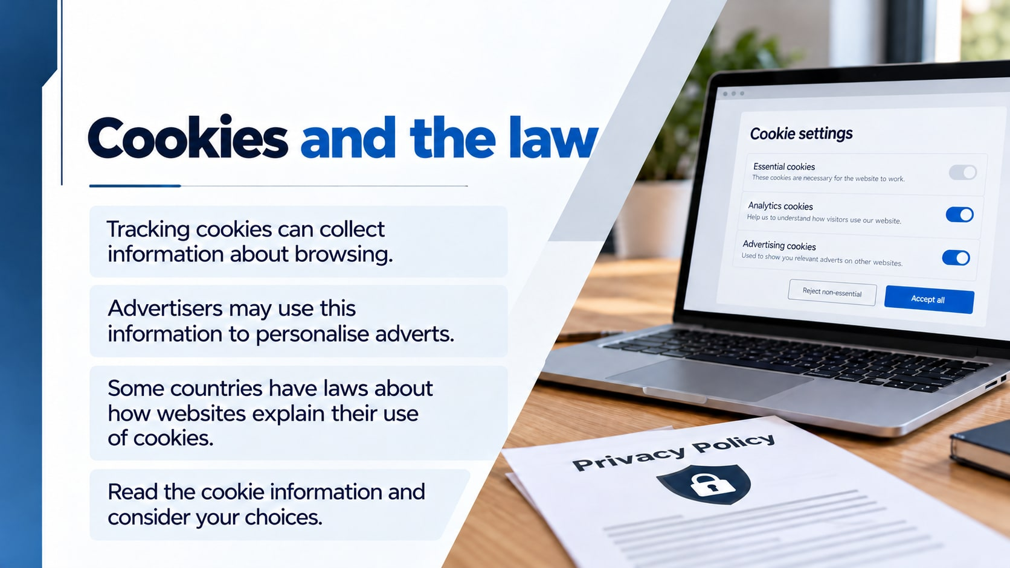
Notes:
Book page 37. Discuss tracking, personalised advertising and that cookie transparency rules differ between countries. Pupils review choices in a fictional example.
Visuals: original AI-generated images. Curriculum: https://github.com/rayjoshuaa/rayjoshuaa.github.io/blob/main/lesson-content-y7.js . Textbook: Oxford International Lower Secondary Computing Student Book 7, section 2.1, printed pages 34–37.

Slide 14
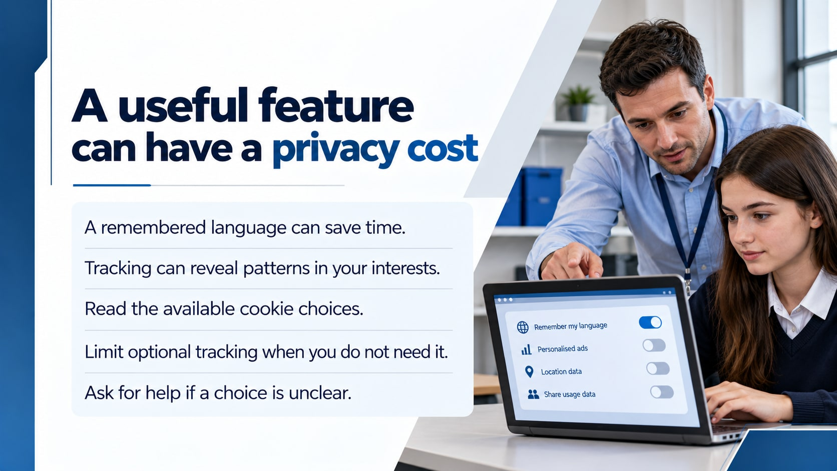
Notes:
Connect benefit and risk rather than labelling every cookie good or bad. Essential and optional cookies may be presented differently. Rejecting optional tracking can reduce this form of data collection but does not make someone anonymous or remove all tracking. Blocking all cookies can break some site functions. Follow school policy and avoid changing managed browser settings in class.
Visuals: original AI-generated images. Curriculum: https://github.com/rayjoshuaa/rayjoshuaa.github.io/blob/main/lesson-content-y7.js . Textbook: Oxford International Lower Secondary Computing Student Book 7, section 2.1, printed pages 34–37.

Slide 15
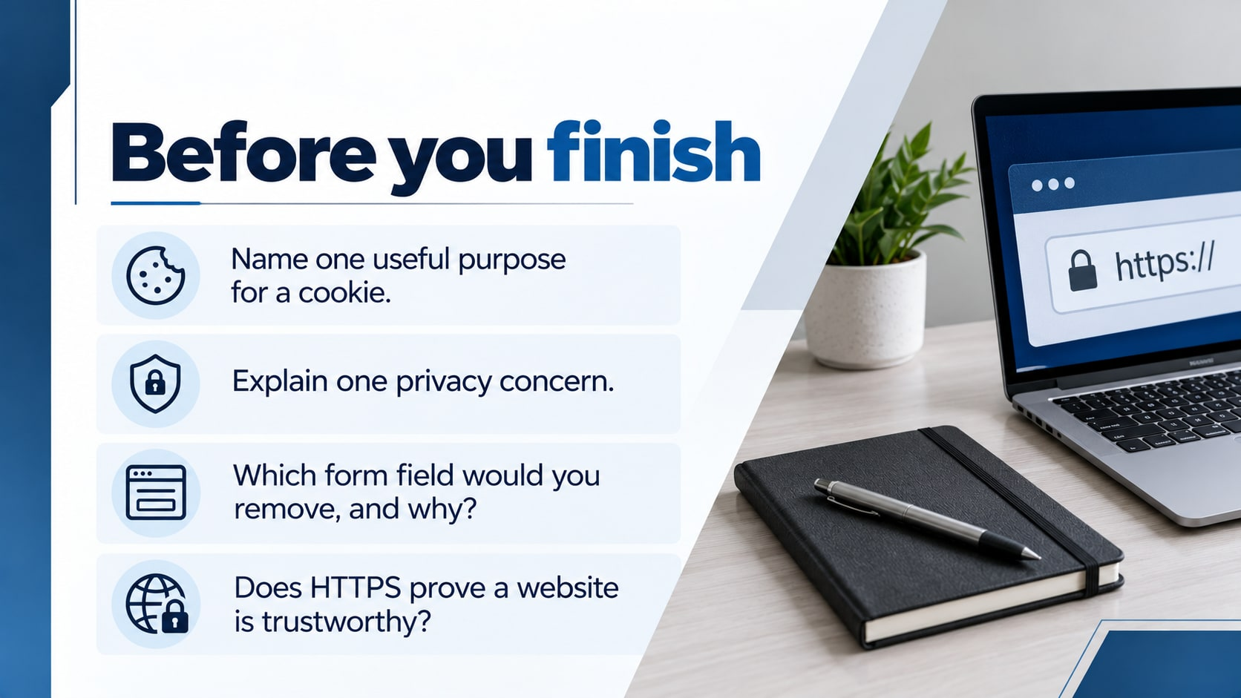
Notes:
Learning check before the activity. Ask pupils to explain one useful cookie, one privacy concern, an unnecessary form field and why HTTPS does not prove trustworthiness.
Visuals: original AI-generated images. Curriculum: https://github.com/rayjoshuaa/rayjoshuaa.github.io/blob/main/lesson-content-y7.js . Textbook: Oxford International Lower Secondary Computing Student Book 7, section 2.1, printed pages 34–37.

Slide 16
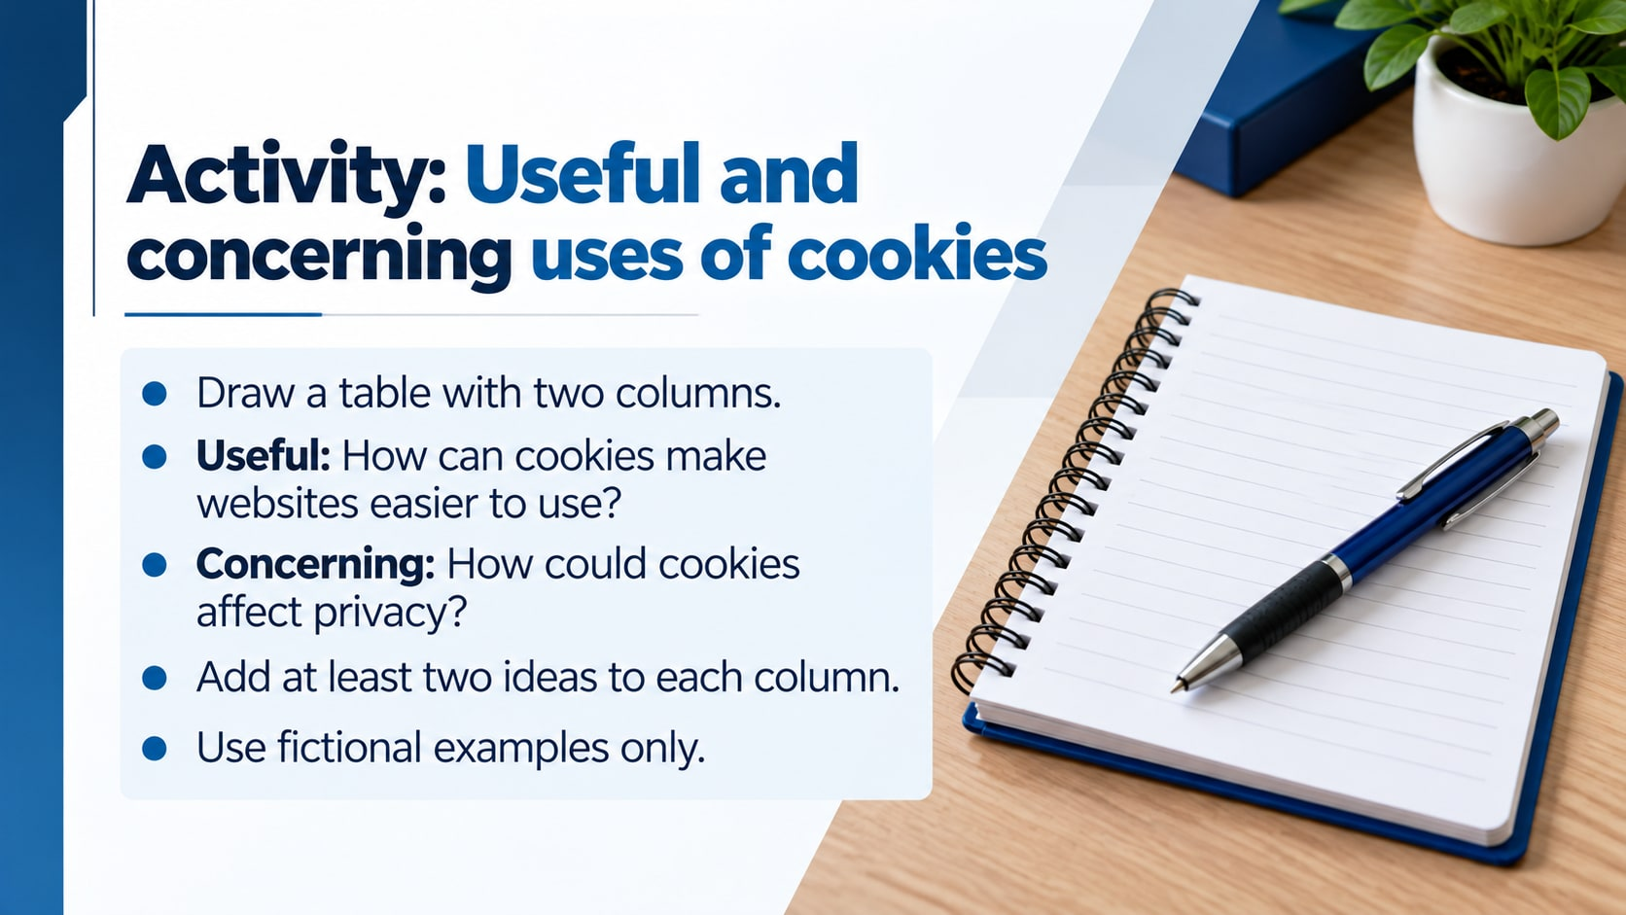
Notes:
Textbook page 37: pupils draw two columns showing useful and concerning uses of cookies. Use fictional examples.
Visuals: original AI-generated images. Curriculum: https://github.com/rayjoshuaa/rayjoshuaa.github.io/blob/main/lesson-content-y7.js . Textbook: Oxford International Lower Secondary Computing Student Book 7, section 2.1, printed pages 34–37.

